Slide 1

Welcome to "TechHub"
Where Innovation Meets Code!

Slide 2
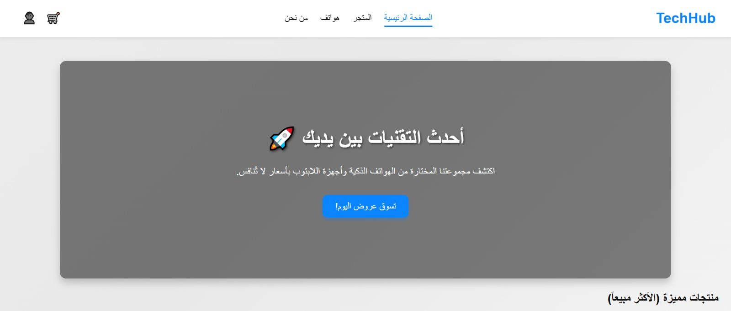


Slide 3
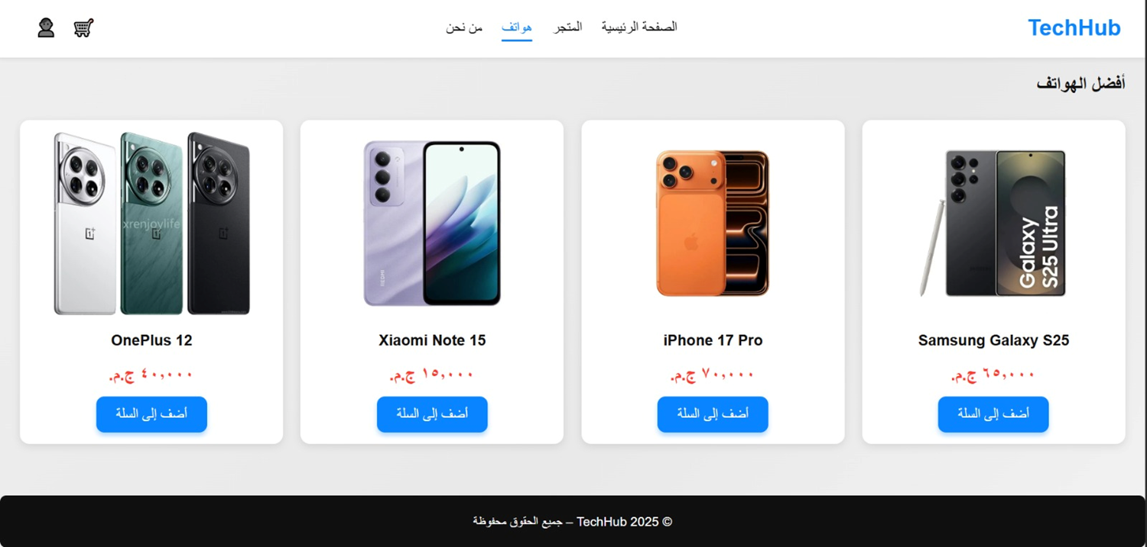


Slide 4
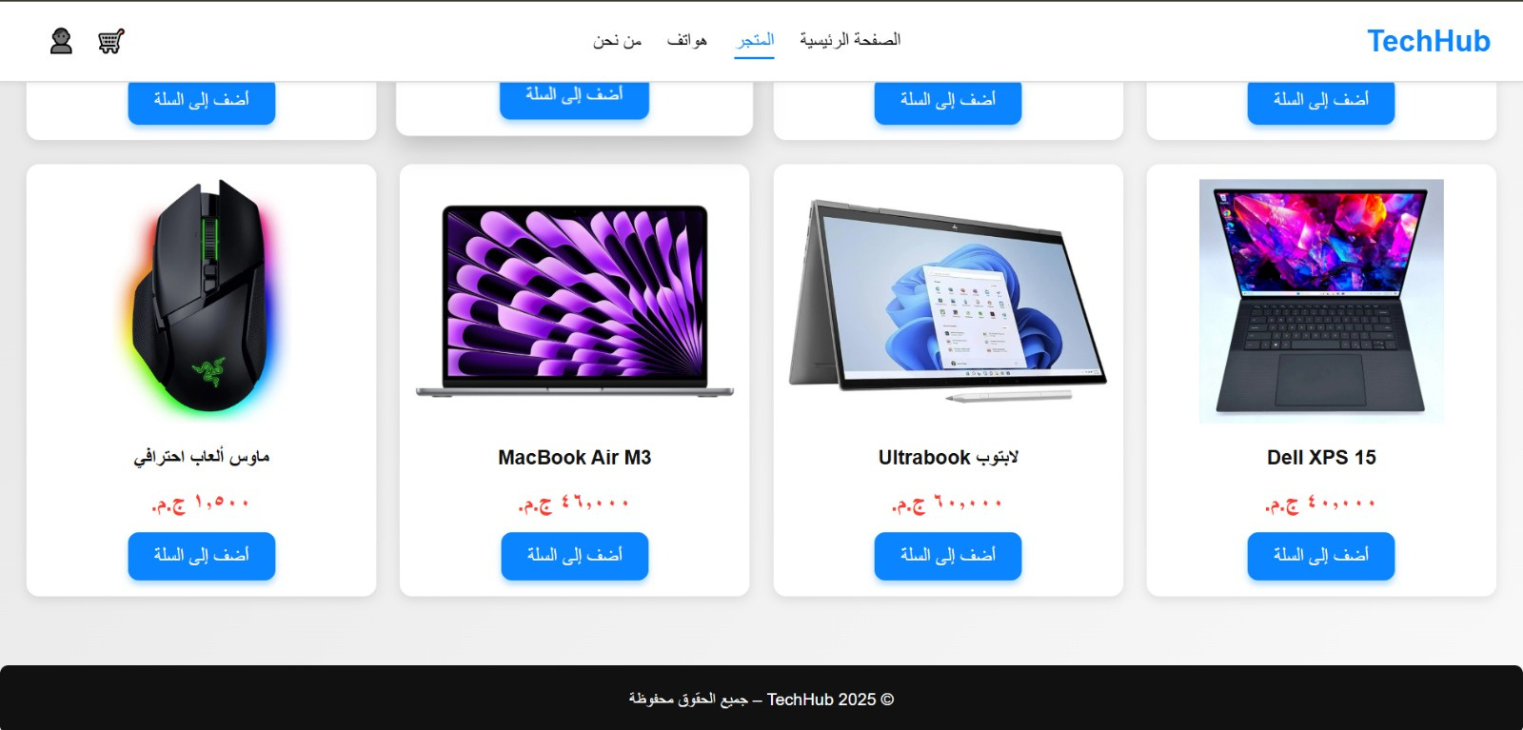

Slide 5
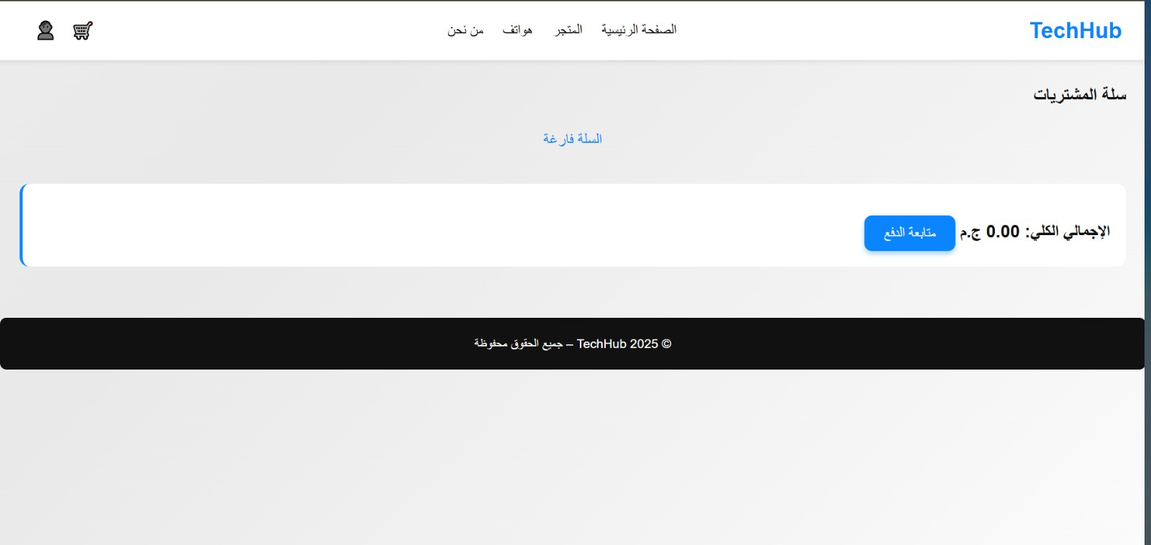

Slide 6


SO HOW DID WE CREATE THIS WEBSITE?
html
javascript
css

Slide 7
WHY DID WE USE HTML ?
  We used HTML to build the main structure of the website.
  We created the Home, Store, and Cart pages.
  We displayed the products using elements such as:
img, h2, p, and button.
  We organized the content into clear sections.
  HTML is the foundation that supports the entire website's appearance.

Slide 8
WHY DID WE USE CSS ?
  We used CSS to style all website elements.
  Designed the product cards (images, text, buttons).
  Used Flexbox/Grid to arrange the products.
  Formatted the colors, backgrounds, and margins.
  Made the website look professional and consistent.

Slide 9
WHY DID WE USE JAVASCRIPT ?
  Adding Interaction and Functionality with JavaScript
  Enable the Add to Cart button
  Dynamicly add products to the cart
  Automatically calculate the total price
  Update the number of products without reloading the page
  JavaScript is what added the animation and interactivity to the website

Slide 10
Thank
YOU

